Slide 1
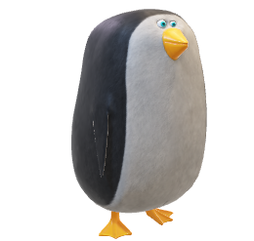
PengWin
Protect Penguins, start from Zooh! Zurich
Team Members: Neeha, Sandeep, Houraalsadat, Yajie

Slide 2
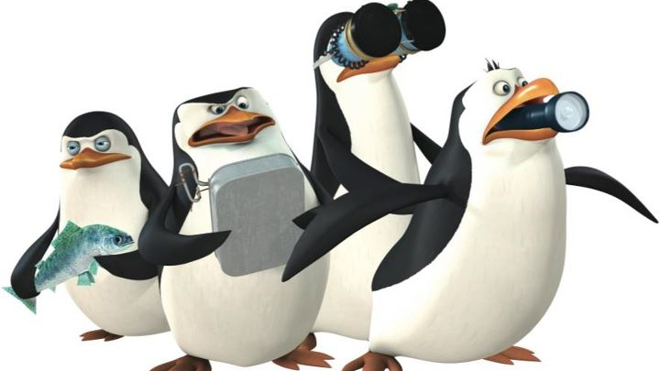
Penguins are in trouble! We need to act!

Slide 3
Solution
What
An App
Who, When, Where
Zoo visitors

Slide 4
Why?
Fun
interactive information
-> visit informative and enjoyable
Education
1.2 million visitors/year
-> encourage public to adapt a sustainable way of living

Slide 5
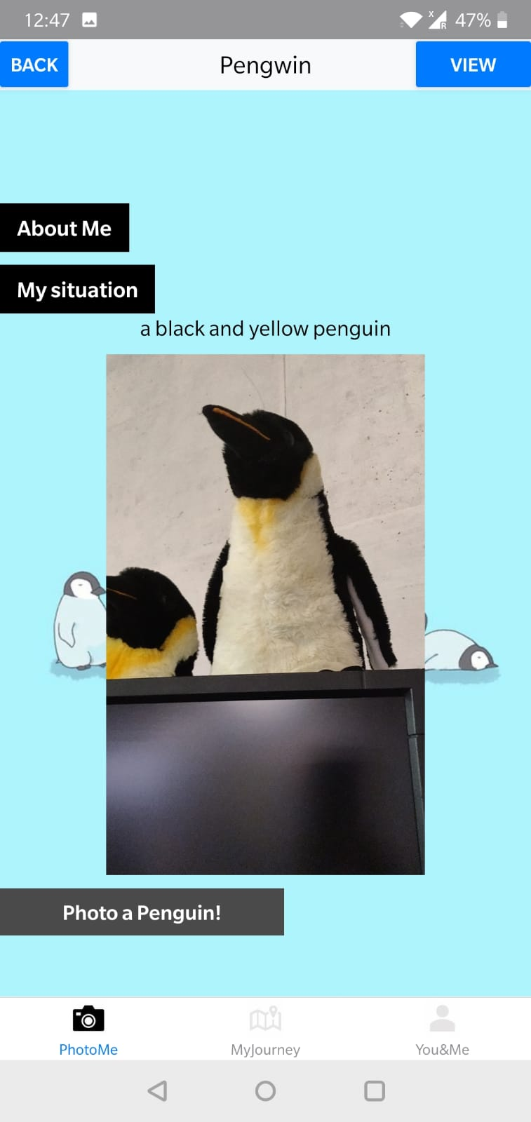
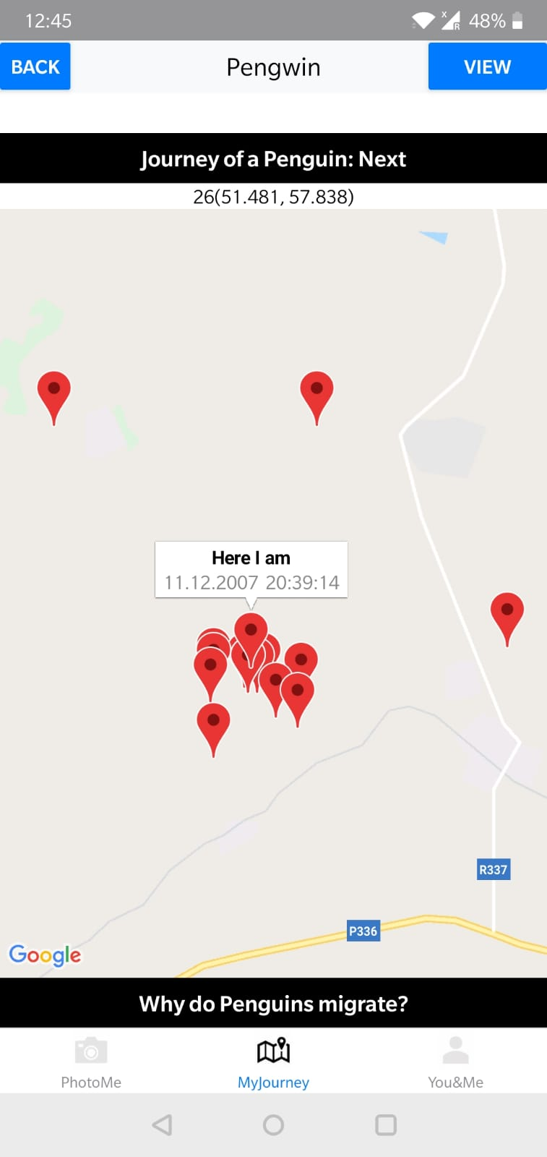
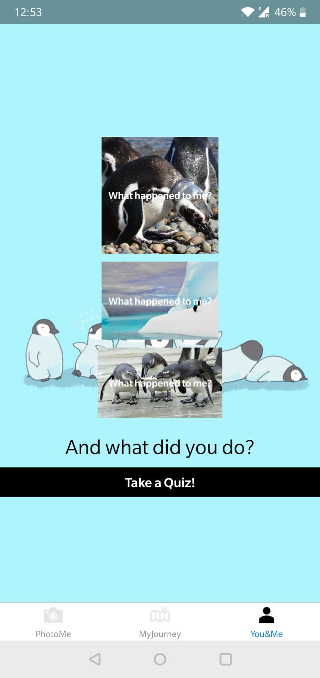
Functionalities
Know Penguins from Photos
Relate People to Penguin
Learn about Penguin Migration

Slide 6
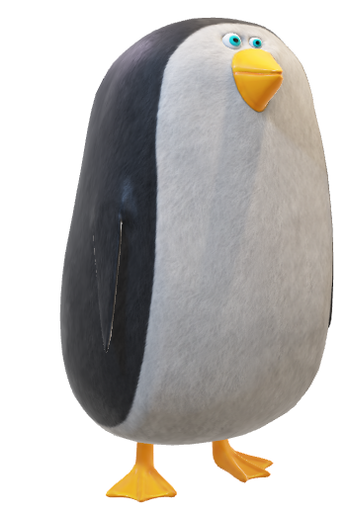
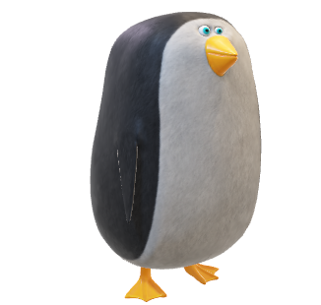


Demo

Slide 7
Future Plans
October 2019
March 2020
Rollout at Zooh! Zurich
Share of information and exchange programs
2019 |  |  |  | 2020
January 2020
October 2020
Partnerships with other Zoos having penguins
Saving the penguins on Global Scale

Slide 8
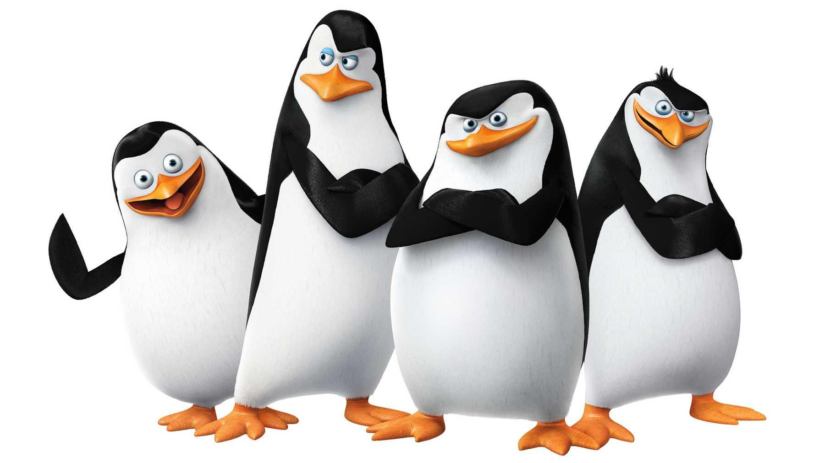
Save the penguins,
start from Zooh! Zurich

